Slide 1










Walmart Stock Analysis
Presented By:
Shubham
Sai Charan
Akhil
Guided by:
DE Expert Venkat Sir

Slide 2
Objective:-
Build a End-to-End Data Engineering Pipeline to analyze the Stock Data using Big Data technologies
Identify Opportunities: Analyze historical stock trends to pinpoint potentially lucrative investment opportunities.
Manage Risk: Identify stocks with higher volatility and sensitivity to market changes to implement risk mitigation strategies.
Analysis Performed
Batch Processing - Hive
Online Processing - HBASE
Interactive Analysis - Spark-SQL, DataFrame
Streaming Analysis - Spark Streaming

Slide 3
Walmart Dataset:
Stock Files Description
AAL
Rows count - 4334
Column Description
AAOI
Rows count - 2321
Date: The dates on which stocks are traded.
Open: The starting price of a stock at the beginning of a trading day.
High: The highest price at which a stock is traded during the day.
Low: The lowest price at which a stock is traded during the day.
Close: The final price of a stock at the end of a trading day.
Volume: The total number of shares of a stock traded during a specific time.
Adjusted Close: The stock price after considering dividends paid to shareholders.
ABIO
Rows count - 6380
ABMD
Rows count - 8917
Total
Rows count -21952

Slide 4

Data Engineering Solution Architecture
Data Ingestion
Storage / Process
Sources
Visualizations

Slide 5
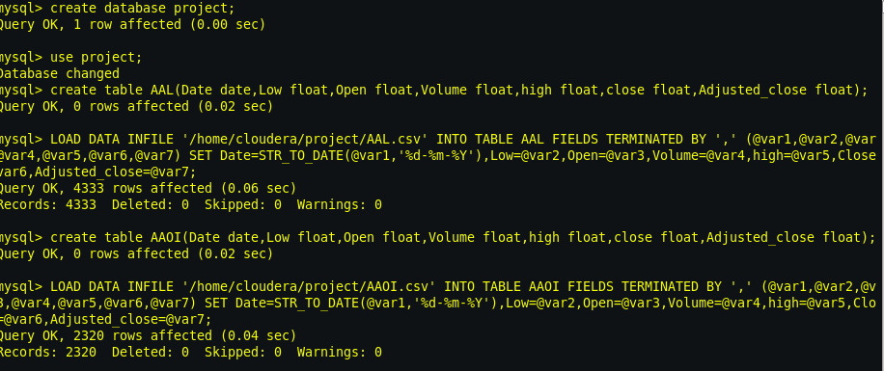
HIVE - Analysis
Step 1 - Source Data
Create Database , Tables & load data-
mysql> create table AAL(Date date,Low float,Open float,Volume float,high float,close float,Adjusted_close float);
mysql> LOAD DATA INFILE '/home/cloudera/project/AAL.csv' INTO TABLE AAL FIELDS TERMINATED BY ',' (@var1,@var2,@var3,@var4,@var5,@var6,@var7) SET Date=STR_TO_DATE(@var1,'%d-%m-%Y'),Low=@var2,Open=@var3,Volume=@var4,high=@var5,Close=@var6,Adjusted_close=@var7;

Slide 6
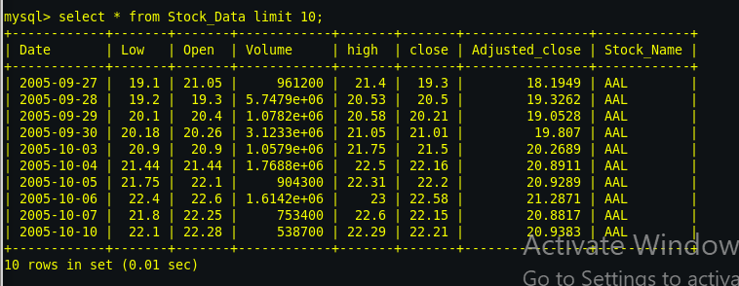
Stock_Data - Merge all four stock files-
mysql> create table Stock_Data(Date date,Low float,Open float,Volume float,high float,close float,Adjusted_close float,Stock_Name varchar(20));
mysql> insert into Stock_Data select * from AAL union all select * from AAOI union all select * from ABIO union all select * from ABMD;

Slide 7

Step 2 - SQOOP Pipeline for MYSQL to HDFS -
[cloudera@quickstart ~]$ sqoop import --connect jdbc:mysql://localhost:3306/project --username root --password cloudera --table Stock_Data --target-dir /user/cloudera/Shubz/Stock_Data.txt -m 1
Step 3 - Creating Schema & Loading data into HIVE –
hive> create table Stock_Data(Date string,Low float,Open float,Volume int,High float,Close float,Adjusted_close float,Stock_Name string) row format delimited fields terminated by ',';
hive> load data inpath 'Shubz/Stock_Data.txt' into table Stock_Data;

Slide 8
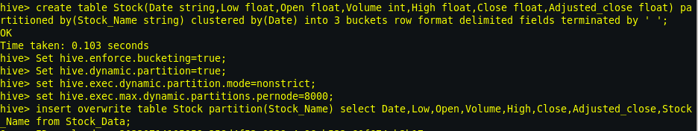
Step 4 - Implementing Partitioning and Bucketing in Hive:
Optimizing Data Storage and Query Performance
hive> create table Stock(Date string,Low float,Open float,Volume int,High float,Close float,Adjusted_close float) partitioned by(Stock_Name string) clustered by(Date) into 3 buckets row format delimited fields terminated by ' ‘;
hive> Set hive.enforce.bucketing=true;
hive> Set hive.dynamic.partition=true;
hive> set hive.exec.dynamic.partition.mode=nonstrict;
hive> set hive.exec.max.dynamic.partitions.pernode=8000;
hive> insert overwrite table Stock partition(Stock_Name) select Date,Low,Open,Volume,High,Close,Adjusted_close,Stock_Name from Stock_Data;

Slide 9
Problem Statements : -
1. Write a Hive query to identify the top three dates that experienced the largest percentage change in stock price (from open to close) for every stock.
------> External table creation:
Hive> create external table Que1(Stock_Name string,Date string,Percentage_change float) row format delimited fields terminated by ',' location '/user/hive/warehouse/Que1/result.txt';

Slide 10
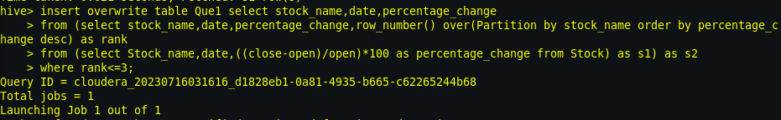
------>Transferring output data to external table
hive> insert overwrite table Que1 SELECT stock_name,date,percentage_change FROM (select stock_name,date,percentage_change,row_number() over(Partition by stock_name order by percentage_change desc) as rank FROM (select Stock_name,date,((close-open)/open)*100 as percentage_change from Stock) as s1) as s2 where rank<=3;
------>MySQL table created (client database)
mysql> create table Que1(Stock_name varchar(20),Stock_date date,Percentage_change float);

Slide 11
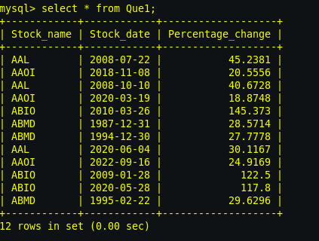
------>Sqoop command to transfer o/p table to MySQL
[cloudera@quickstart ~]$ sqoop export --connect jdbc:mysql://localhost:3306/project --username root --password cloudera --table Que1 --export-dir /user/hive/warehouse/Que1/result.txt/000000_0 --input-fields-terminated-by ','
------>Final output data

Slide 12
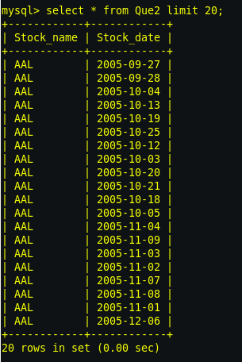
2. write a Hive query to identify the dates where Low is less than average month low for every stock.
SELECT stock_name,date
FROM (select stock_name,date, low,avg(low) over(partition by stock_name,year(date),month(date)) as avg_monthly_low
FROM stock) as s1
WHERE low<avg_monthly_low;

Slide 13
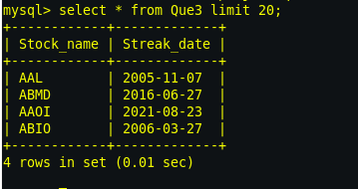
3. Write a Hive query to find the date with the longest consecutive streak of increasing closing prices for every stock
SELECT stock_name, streak_date
FROM (SELECT stock_name, streak_date,ROW_NUMBER() OVER (PARTITION BY stock_name ORDER BY streak_length DESC) AS rn
FROM (SELECT stock_name, date, close,SUM(is_increasing) OVER (PARTITION BY stock_name, grp ORDER BY date) AS streak_length,FIRST_VALUE(date) OVER (PARTITION BY stock_name, grp ORDER BY date) AS streak_date
FROM (SELECT stock_name, date, close,CASE WHEN LAG(close, 1) OVER (PARTITION BY stock_name ORDER BY date) < close THEN 1 ELSE 0 END AS is_increasing,DATE_SUB(date, ROW_NUMBER() OVER (PARTITION BY stock_name ORDER BY date)) AS grp
FROM Stock) as sub) as sub2) as sub3
WHERE rn = 1;

Slide 14
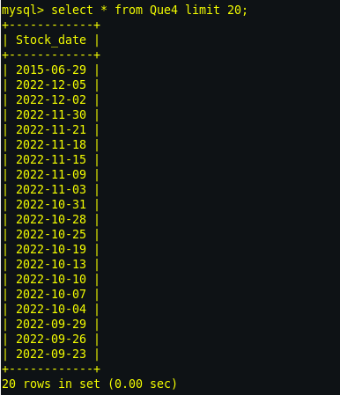
4. write a Hive query to find the dates where AAL open price is higher than AAOI open price OR AAL volume greater than AMBD (write your query in an optimised way)
SELECT s1.date FROM Stock s1
JOIN Stock s2 ON s1.date = s2.date
JOIN Stock s3 ON s1.date = s3.date
WHERE (s1.stock_name = 'AAL' AND s1.open > s2.open AND s2.stock_name = 'AAOI')
OR (s1.stock_name = 'AAL' AND s1.volume > s3.volume AND s3.stock_name = 'AMBD')

Slide 15
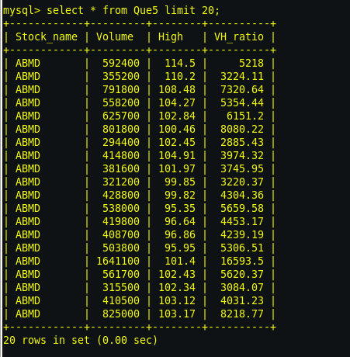
5. write a Hive query to calculate VH ratio(volume to hive ratio).
SELECT Stock_Name,Volume,High, volume / adjusted_close AS vh_ratio FROM Stock;

Slide 16
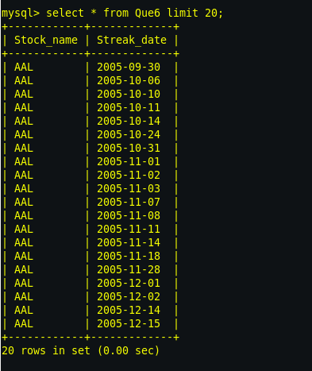
6. Write a Hive query to find the dates where previous day close and current day open difference is greater than 0 for each stock.
SELECT stock_name, date
FROM (SELECT stock_name, date,lag(close,1) OVER (PARTITION BY stock_name ORDER BY date) AS prev_close,open
FROM Stock) sub
WHERE (open - prev_close) > 0;

Slide 17
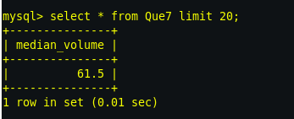
7. Find median of volume for ABIO.
SELECT percentile(volume, 0.5) AS median_volume
FROM Stock
WHERE stock_name = 'ABIO';

Slide 18
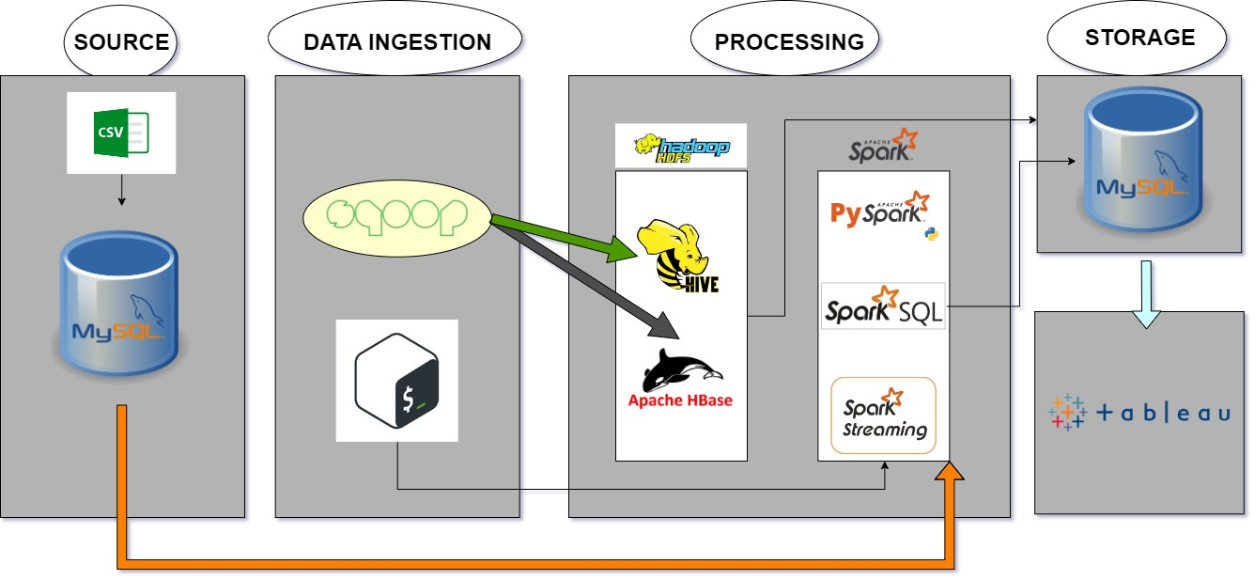
Data Engineering Solution Architecture
Batch analysis
Batch processing
Interactive analysis
Online processing
Online analysis
Spark pipeline

Slide 19
PySpark - Analysis
IMPORT LIBRARIES –
✓ import findspark
✓ import pyspark
✓ from pyspark.sql import SparkSession
✓ from pyspark.sql.functions import *
READ DATAFILE
spark1 = SparkSession.builder.appName('Walmart_project').getOrCreate()
df=spark1.read.csv("walmart_stock.csv",inferSchema=True,header=True)

Slide 20
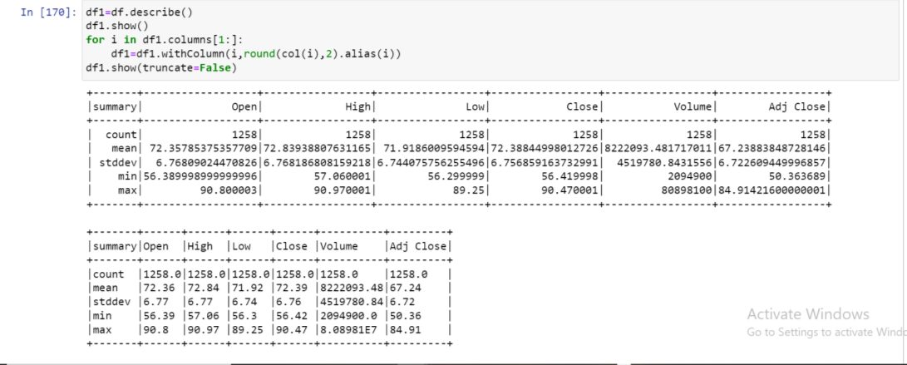
scenario 2: There are too many decimal places for mean and stddev in the describe() dataframe. Format the numbers to just show up to two decimal places.Pay careful attention to the datatypes that .describe() returns, we didn't cover how to do this exact formatting,but we covered something very similar.

Slide 21
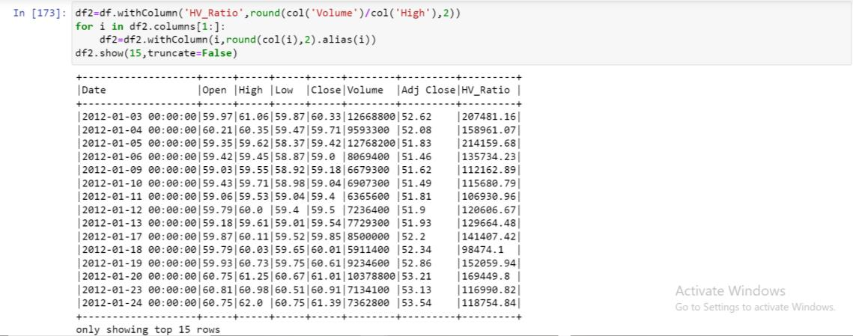
scenario3: Create a new dataframe with a column called HV Ratio that is the ratio of the High Price versus volume of stock traded for a day.?

Slide 22
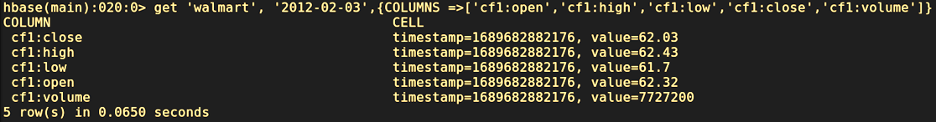
HBASE- Analysis
mysql> create table walmart_stock(date varchar(20), open float, high float, low float, close float, volume int,adj_close float);
mysql> LOAD DATA LOCAL INFILE '/home/cloudera/walmart_stock.csv' into table walmart_stock columns TERMINATED BY "," LINES TERMINATED BY '\n' ignore 1 lines;
sqoop import --connect jdbc:mysql://localhost:3306/project --username root --password cloudera --table walmart_stock --hbase-table walmart --hbase-row-key date --column-family cf1 --hbase-create-table -m 1
get 'walmart', '2012-02-03',{COLUMNS =>['cf1=open','cf1=high','cf1=low','cf1=close','cf1=volume']}

Slide 23
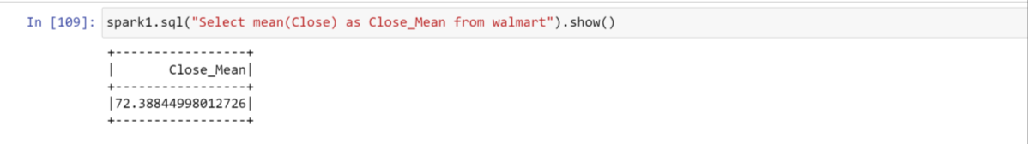
scenario4: What day had the Peak High in Price?
Spark SQL - Analysis
➢ df.createOrReplaceTempView("walmart")
scenario5: What is the mean of the Close column?

Slide 24
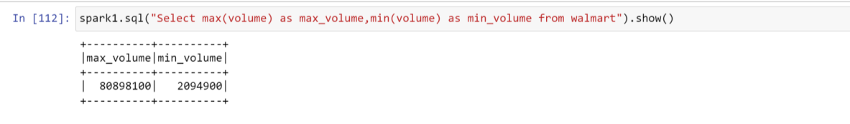
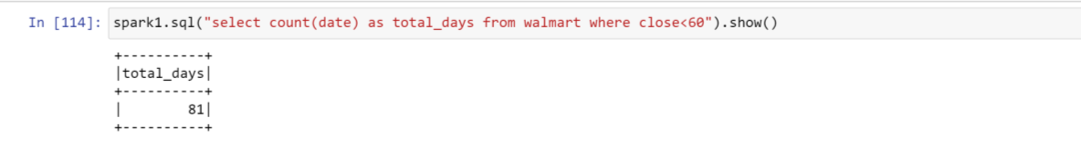
scenario6: What is the max and min of the Volume column?
scenario7: How many days was the Close lower than 60 dollars?

Slide 25
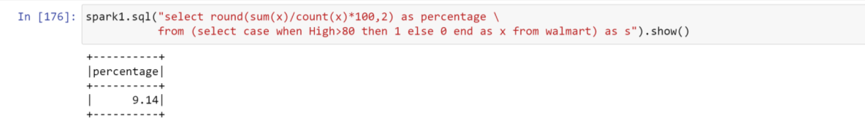
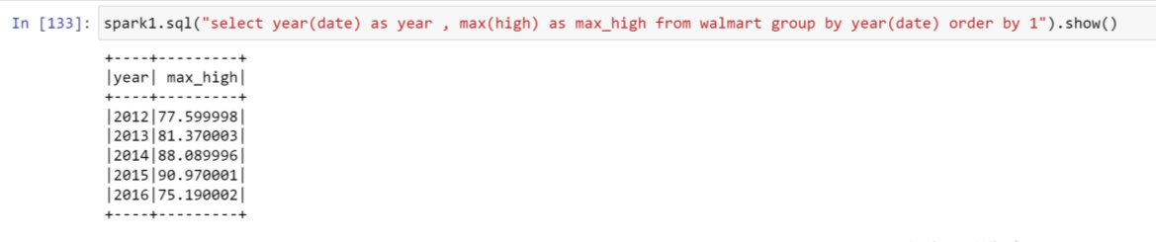
Scenario8: What percentage of the time was the High greater than 80 dollars ? In other words, (Number of Days High>80)/(Total Days in the dataset)
Scenario9: What is the max High per year?

Slide 26
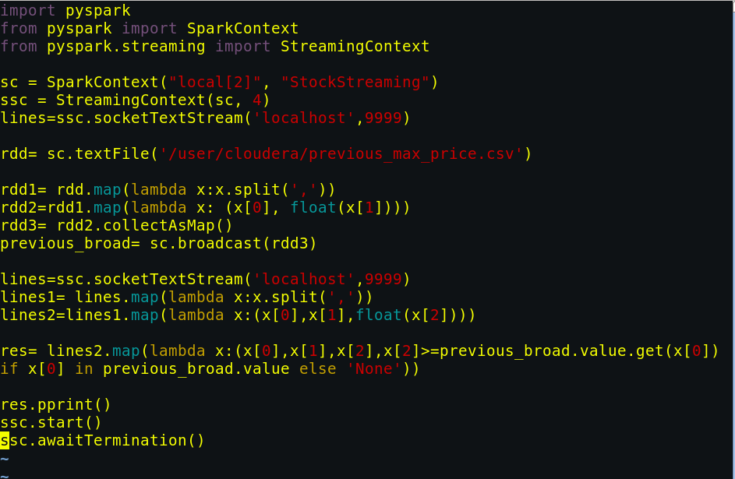
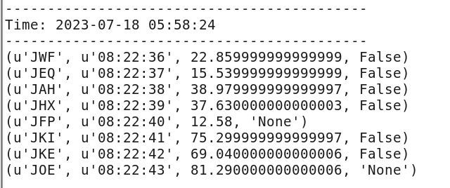
Spark Streaming- Analysis
Problem Statements : -
Reads the static data of previous max price
b) Captures the streaming data every few seconds
c) Compares the current stock price of each company from the data stream with the static data of previous max price and
d) Flags i.e. displays the details when the current price reaches or goes above the previous max price.
[cloudera@quickstart ~]$ vi shubham.py
[cloudera@quickstart ~]$ spark-submit shubham.py
[cloudera@quickstart ~]$ ./stock_details_socket.shstock_stream_data.csv | nc -lk 9999

Slide 27
Visualization

Slide 28
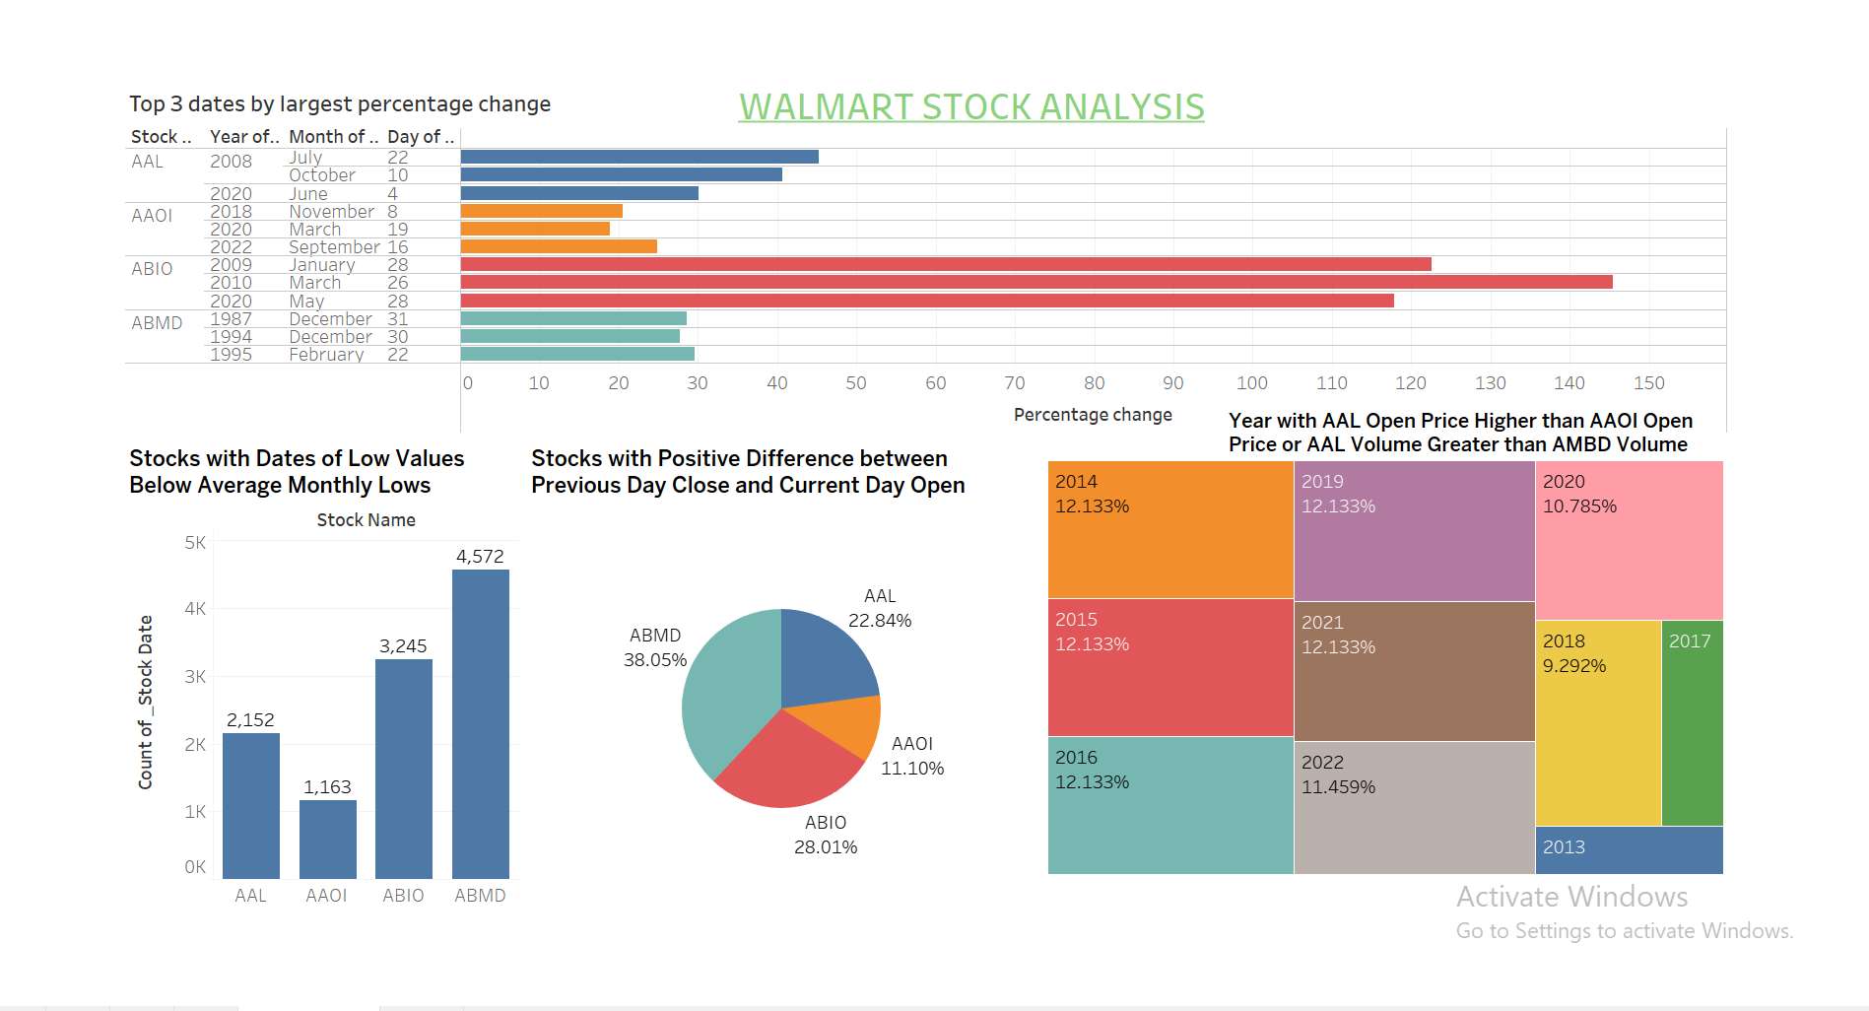


















Slide 29

Thank You
Special Thanks to Our Mentor : DE Expert Venkat Sir

